Slide 1
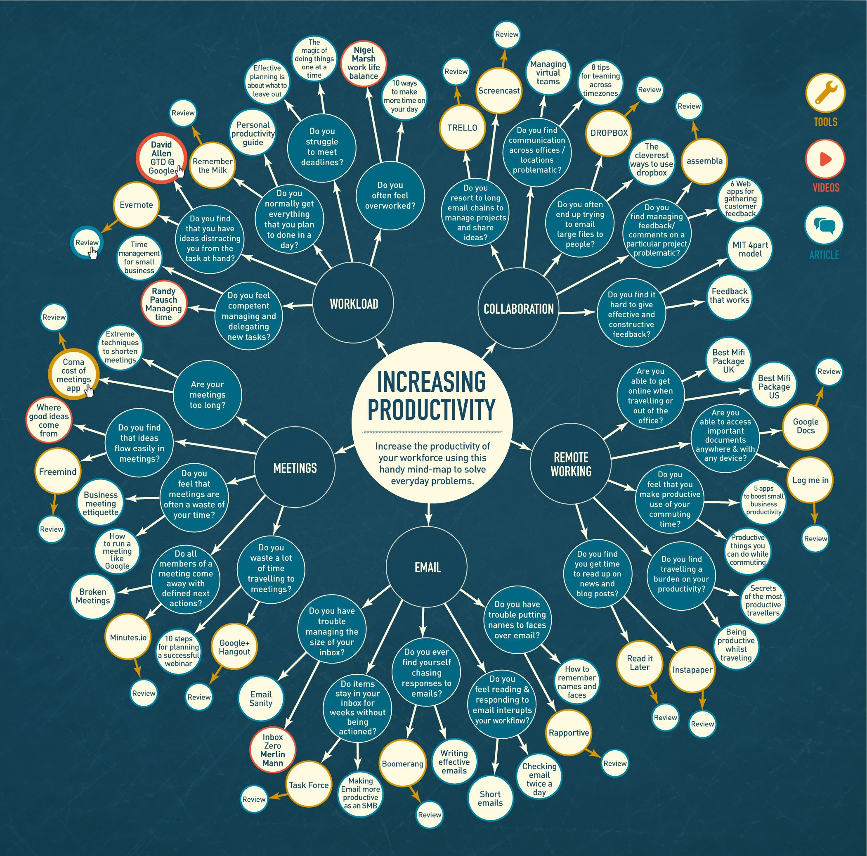
Mindmap in Javascript
Students
Supervisor
Correlator
Client
De Boni Jonathan
Zorloni Gabriele
Galli Vanni
-
Galli Vanni
Degree Course
N° Project
Year
Date
Computer Engineering
C10007
2018/2019
03/05/2019
Abstract
Mindmap, in Italian “mappa mentale”, is a diagram used to visually organize information. It is organized in a hierarchical manner and, with the use of connectors, the relationships between the individual components are displayed, so as to facilitate the management of large projects for the user. Information is often keywords, concepts, images or sketches that allow the user to associate words with images.
The purpose of this semester project is to develop a Javascript program (which can therefore be used on the web by all commercial browsers) to draw mind maps through functions we have made available through the use of the "mxGraph.js" and " FileSaver.js ".
This document provides a detailed and architectural explanation to make the user understand how our application was designed and developed. The required result was fully achieved with the addition of additional features that made it possible to make the final product responsive and functional, so as to allow the user a better experience within the mindmap design
Targets
The first part of the project consists of an analysis of the functioning of Mindmaps and their use. In the second part it is required to analyze the tools on the market that allow you to create and manage a Mindmap. The final aim of this semester work is to develop a tool for creating and manipulating a Mindmap using Javascript technology (usable via web).
Conclusion
The real difficulty of this project was to make our application better and more functional in the development of projects that would allow the construction of Mindmap, as many software allow the construction of graphs but are not specific for Mindmaps.
The use of our software allows you to customize your project making it unique and fast to develop, to save it for a future modification and possibly to integrate with similar applications.

